Slide 1

Cracked Cell Solutions and Research Opportunities
Andrew M. Gabor
CTO – BrightSpot Automation
This material is based upon work supported in part by the U.S. Department of Energy’s Office of Energy Efficiency and Renewable Energy, in the Solar Energy Technologies Program, under Award Number DE-EE0008152

Slide 2


PVRD2 Project
“Improving solar panel durability through novel panel designs and advanced manufacturing equipment”
Award #DE-EE0008152
BrightSpot Automation – Lead
  Rob Janoch
  Andrew Anselmo
Univ. of Central Florida/ FSEC – sub
  Hubert Seigneur
  Eric Schneller
D2 Solar – sub
  Mike Rowell
  Duncan Harwood

Slide 3
Publications
Full Author List | "Paper Title" | Conference
A.M. Gabor, J. Lincoln, E.J. Schneller, H. Seigneur, M.W. Rowell, D.J. Harwood | Should Low Temperature Exposure Precede Mechanical Load Testing of Silicon Solar Panels? | 2018 PVRW
M.W. Rowell, S.G. Daroczi, D.J. Harwood, A.M. Gabor | The effect of laminate construction and thermal history on the fracture strength of solar cells | 2018 PVRW
Andrew M. Gabor, Jason Lincoln, Eric J. Schneller, Hubert Seigneur, Rob Janoch, Andrew Anselmo, Duncan W. J. Harwood, Michael W. Rowell | Compressive Stress Strategies for Reduction of Cracked Cell Related Degradation Rates in New Solar Panels and Power Recovery in Damaged Solar Panels | 2018 WCPEC-7
Hubert Seigneur, Jason Lincoln, Eric Schneller, Andrew M. Gabor | Accelerating Cyclic Loading | 2018 WCPEC-7
Michael W. Rowell, Shandor G. Daroczi, Duncan W.J. Harwood, Andrew M. Gabor | The Effect of Laminate Construction and Temperature Cycling on the Fracture Strength and Performance of Encapsulated Solar Cells | 2018 WCPEC-7
Andrew M. Gabor, Robert Lockhart, Ankil Sanghvi, Eric J. Schneller, Jason Lincoln, Hubert Seigneur | Cracked Up: how should we classify and respond to various EL defects in silicon PV modules? | 2019 PVRW
Eric J. Schneller, Hubert Seigneur, Jason Lincoln, Joseph Walters, Andrew Gabor | Re-Evaluating Solar Panel Mechanical Durability Testing: Case Study of Commercial Modules | 2019 PVRW
Andrew M. Gabor, Rob Janoch, Andrew Anselmo, Jason Lincoln, Eric J. Schneller, Hubert Seigneur, Duncan W. J. Harwood, Michael W. Rowell | Mounting Rail Spacers for Improved Solar Panel Durability | 46th IEEE PVSC

Slide 4
Publications
Full Author List | "Paper Title" | Conference
Eric J. Schneller, Hubert Seigneur, Jason Lincoln, Andrew M. Gabor | The Impact of Cold Temperature Exposure in Mechanical Durability Testing of PV Modules | 46th IEEE PVSC.
Hubert Seigneur, Eric Schneller, Andrew M. Gabor, Michael Rowell, Jason Lincoln, et. al. | Microcrack Formation in Silicon Solar Cells during Cold Temperatures | 46th IEEE PVSC.
Hubert Seigneur, Andrew M. Gabor, Eric Schneller, Jason Lincoln | Electroluminescence-Testing Induced Crack Closure in PV modules | 46th IEEE PVSC.
Hubert Seigneur, Eric J. Schneller, Dylan Colvin, Rob Janoch, Andrew Anselmo, Andrew M. Gabor | The Influence on Cracked Solar Cell Degradation from Hurricane Dorian Wind Loading Events and the Influence of RailPad Bracing Elements | 2020 PVRW
Andrew M. Gabor, Eric J. Schneller, Hubert Seigneur, Michael W. Rowell, Dylan Colvin, Michael Hopwood, Kristopher Davis | The Impact of Cracked Solar Cells on Solar Panel Energy Delivery | 47th IEEE PVSC Conf.
Andrew M. Gabor | Electroluminescence Defect Testing of Solar Panels and Ultraviolet Fluorescence Defect Testing of Solar Panels | NABCEP Virtual Continuing Education Conf
Andrew M. Gabor and Duncan W. J. Harwood | Do Those Short Solar Cells Cracks That I Can Barely See in EL Really Matter? | 2021 PVRW
Hubert Seigneur, Hossein Ebrahimi, Andrew M. Gabor | The Role of Material Properties and Geometries in Microcrack Formation in Silicon Solar Cells During Cold Temperatures | 2021 PVRW

Slide 5
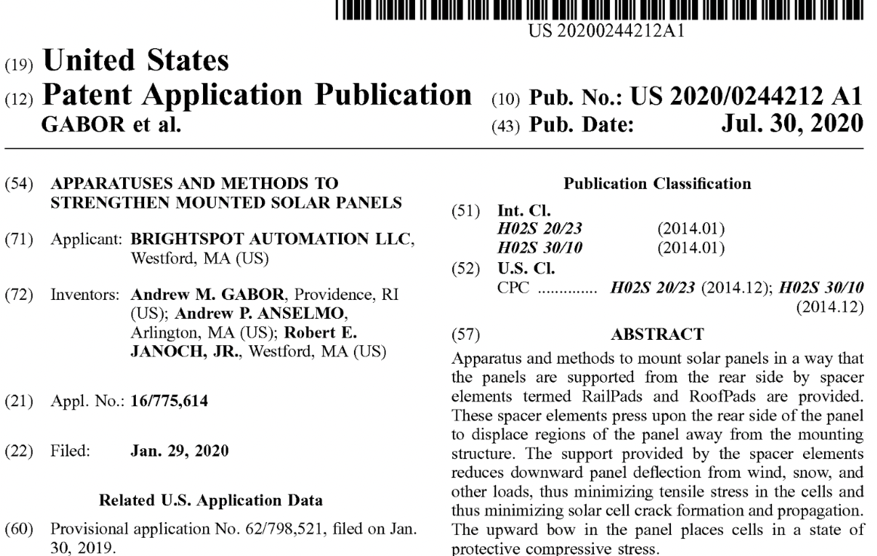
Patent Application - RailPads

Slide 6
Main Research Themes
Improved Understanding of Why Cracks Form and Cause Degradation in Solar Cells
Improved Durability Testing Methods With Respect to Cracked Cells
New Module Designs and Related Manufacturing Methods & Equipment
New Module Mounting Designs

Slide 7
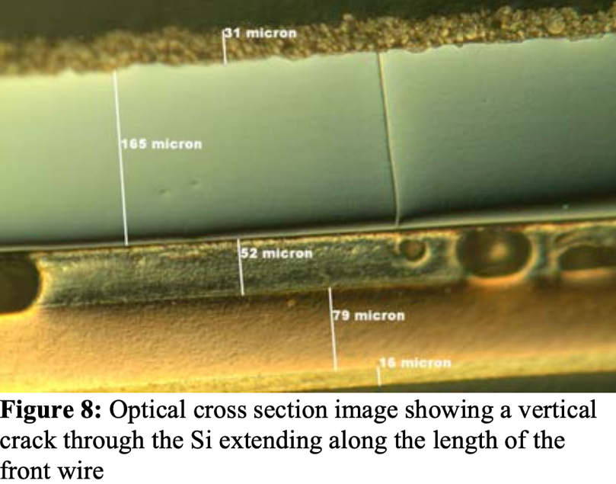
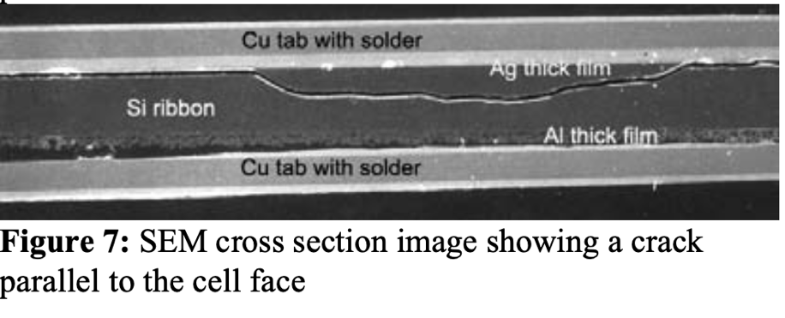
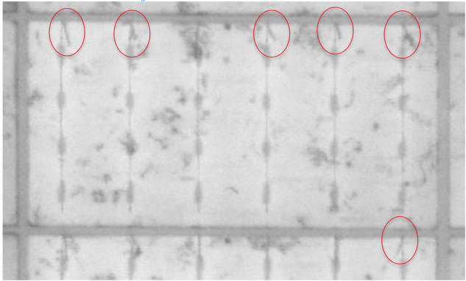
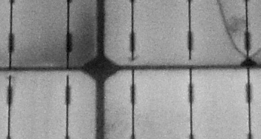
Terminology
Microcrack: A sub-millimeter long crack that can’t be seen in EL
  Soldering induced damage
  Laser cutting
  Handling problems
  Extreme cold exposure
V-crack: A short (0.5-2mm) angled crack or cracks at the tips of busbars or the laser cut edge of cells that is visible in high resolution EL if one looks closely
Closed crack – A long crack, easily seen in EL, with little contrast difference between the two sides
[Gabor – 2006]
  Poor soldering, busbar design, materials
  Poor laser scribing

Slide 8
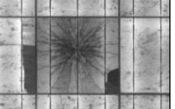
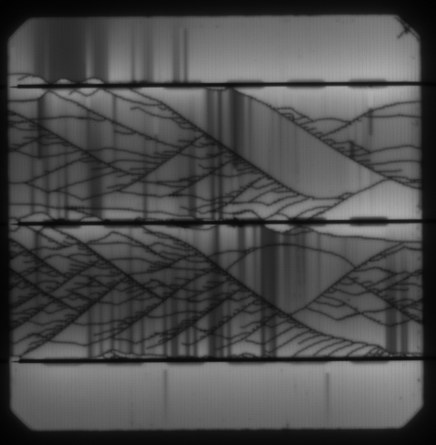
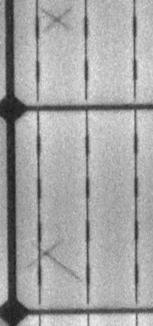
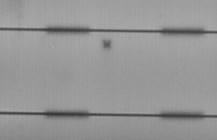
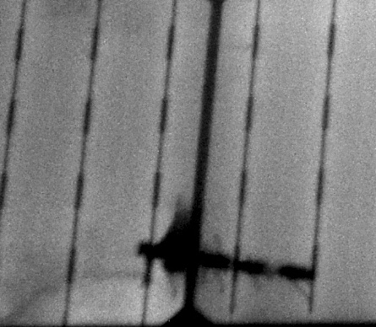
Terminology
Open crack – As above but with significant contrast difference due to front or back metallization becoming discontinuous
Dendritic cracks – A spidery network of cracks from sharp impacts (hail) or from breakage that occurs at high front side loads
X-cracks – Short (few mm’s) cracks, often in an X shape that occur from sharp rear side impacts on polymer backsheet modules
Open
Dendritic (hail, load)

Slide 9
Crack Creation & Evolution
 | Micro-crack creation | V-crack creation | X-crack creation | Dendritic crack creation | Crack propa-gation | Crack opening
Soldering, laser cutting + stringing | X | X
Exposure to below -30C | X
Pre-lamination cell handling, Rear module impacts/drag-marks |  |  | X
Hail, dropping modules, front loads >4000 Pa |  |  |  | X
Static front loading >1500 Pa, transportation? |  |  |  |  | X
Cyclic loading +/- 1000 Pa, thermal cycling |  |  |  |  |  | X

Slide 10
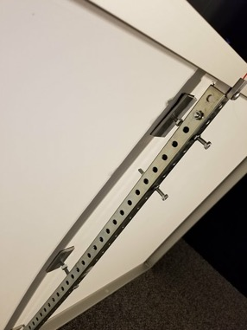
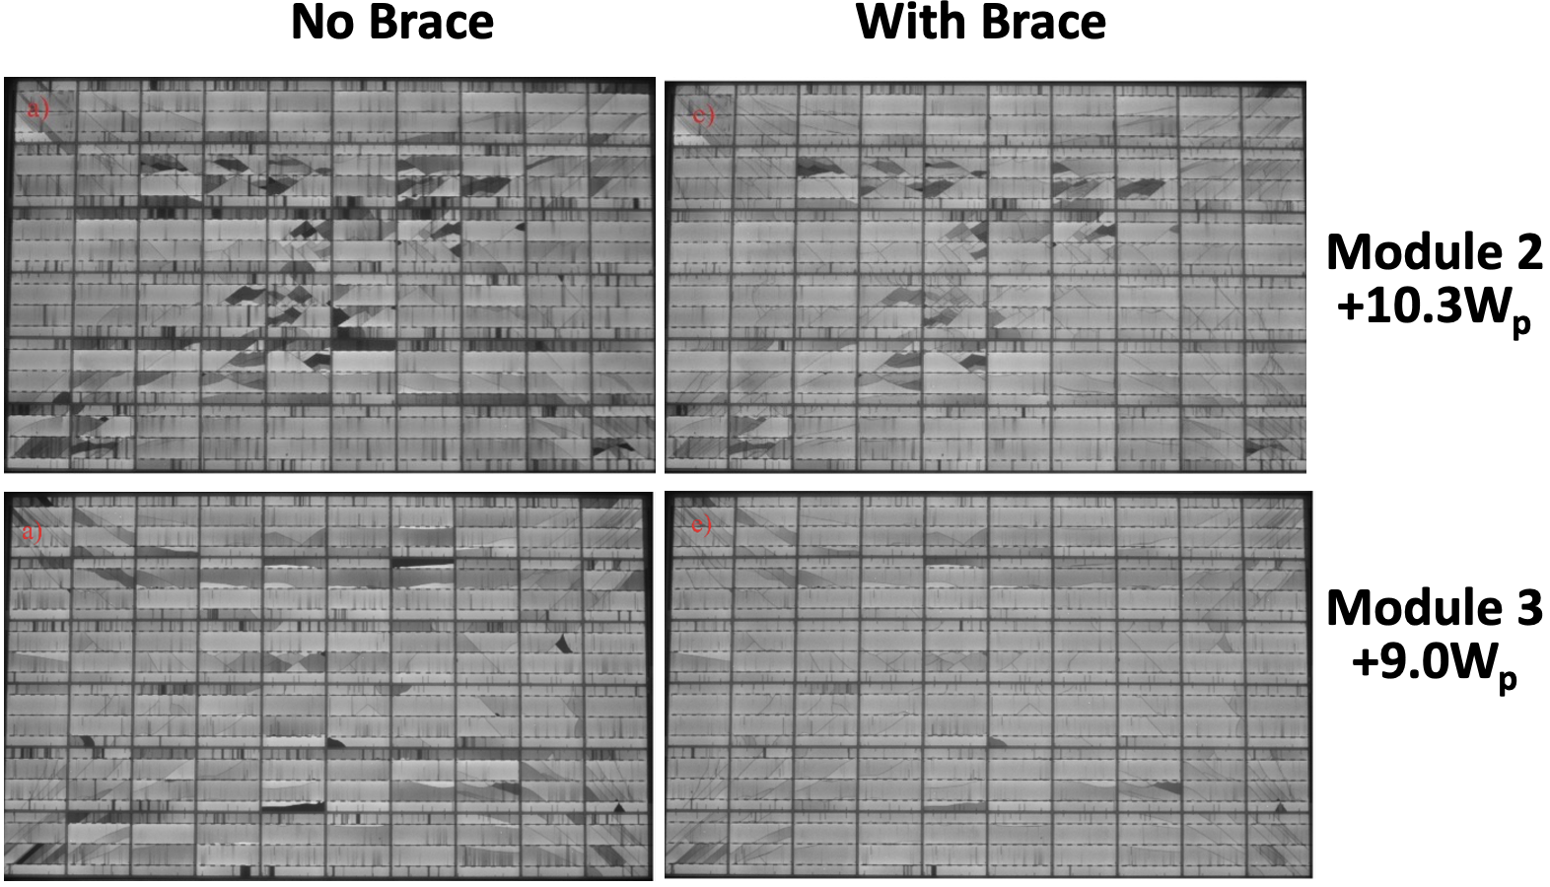
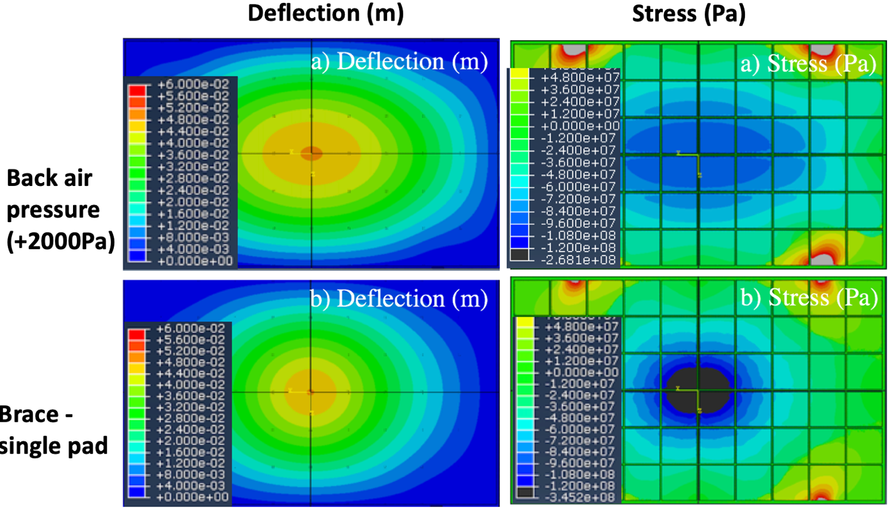
Crack Closure from Rear Pressure
Front loads create damaging tensile stresses
Rear loads create protective or healing compressive stresses

Slide 11
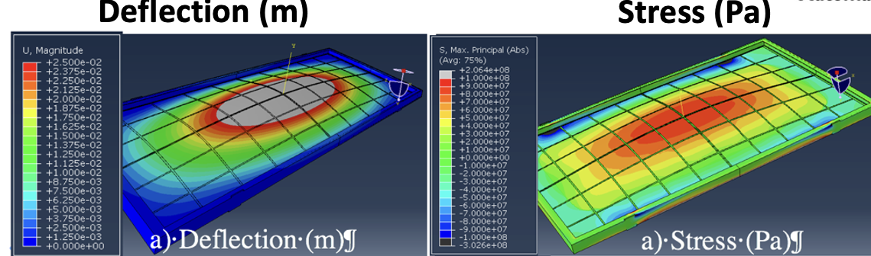
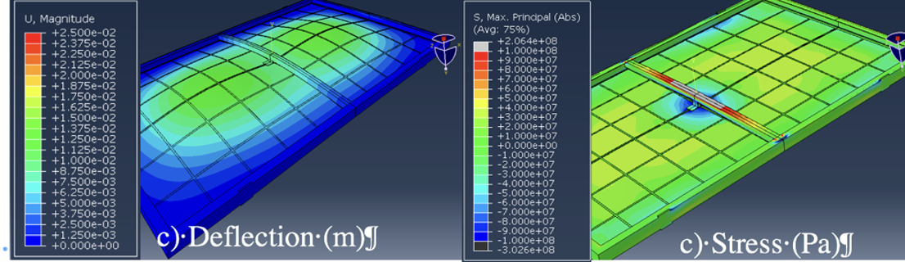
Reduction in Cell Stress Under 2400 Pa Load from Brace
No brace, standard frame
With brace – single pad, lower mass frame

Slide 12
Future Crack Closure and Modeling Experiments
Quantify closure amount – Sandia’s Digital Image Correlation + LoadSpot approach
See if closure effect goes away with time and temperature
Is the effect stronger for front or back metallization?
How much cost and mass can be removed from frame and glass and still come out ahead when using braces?

Slide 13
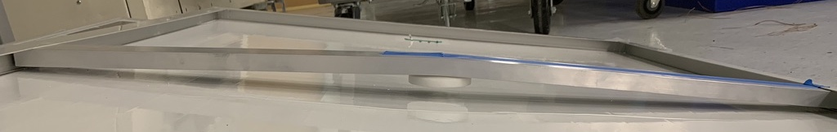
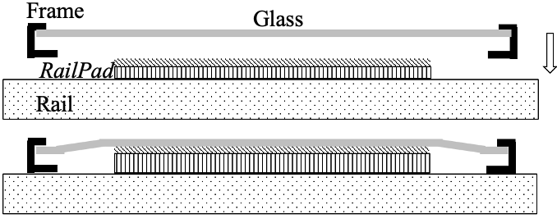
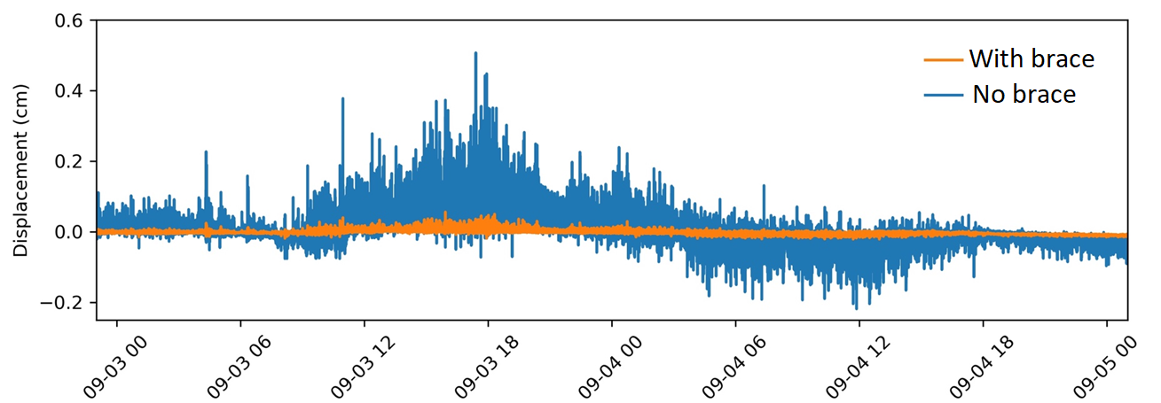
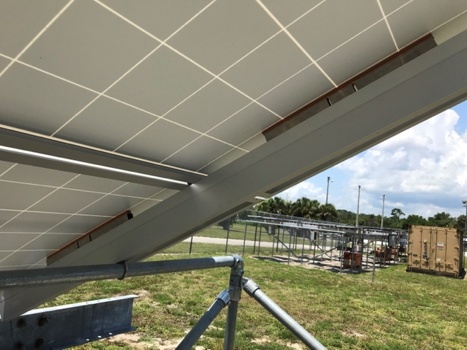
RailPad
Cost-effective braces permanently deform under high load
RailPad concept: use the strength of the mounting rail
  Place a spacer between the rail and the backsheet to limit deflection and to press upward and place cells in a state of protective compressive stress
Module center deflection with & without RailPads during Storm Dorian in FL

Slide 14
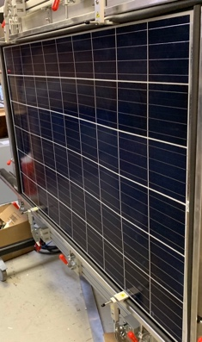
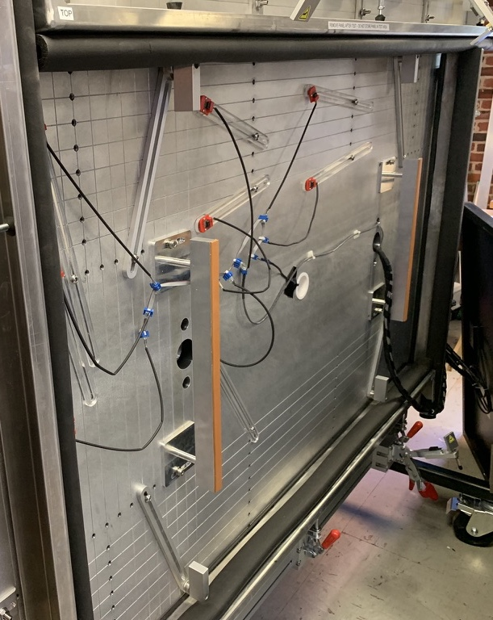
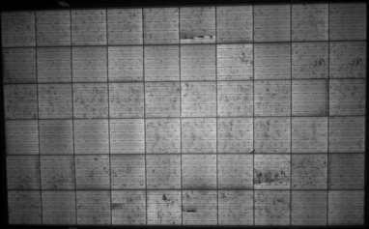
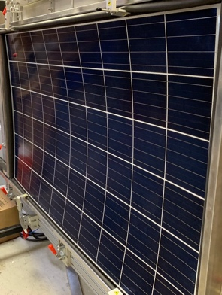
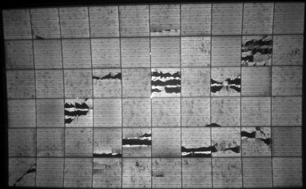
LoadSpot Static Load Testing at -5400 Pa
With RailPad
Then without RailPad

Slide 15
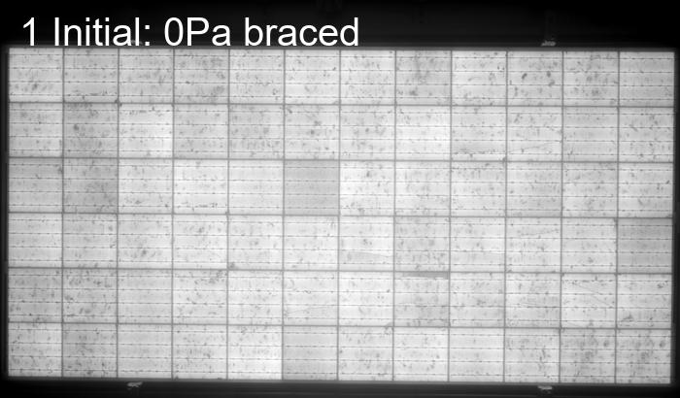
RailPad EL images vs load
Note: view in slideshow mode to see gif images

Slide 16
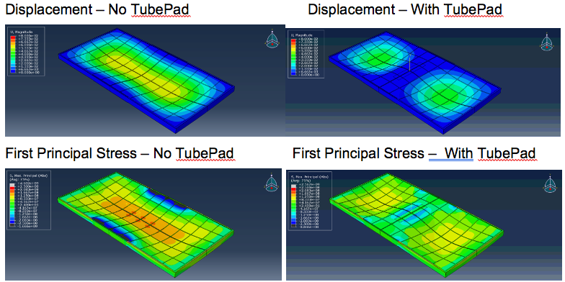
TubePad for Trackers
Solve problem of tracker tube hitting J-boxes under high load

Slide 17
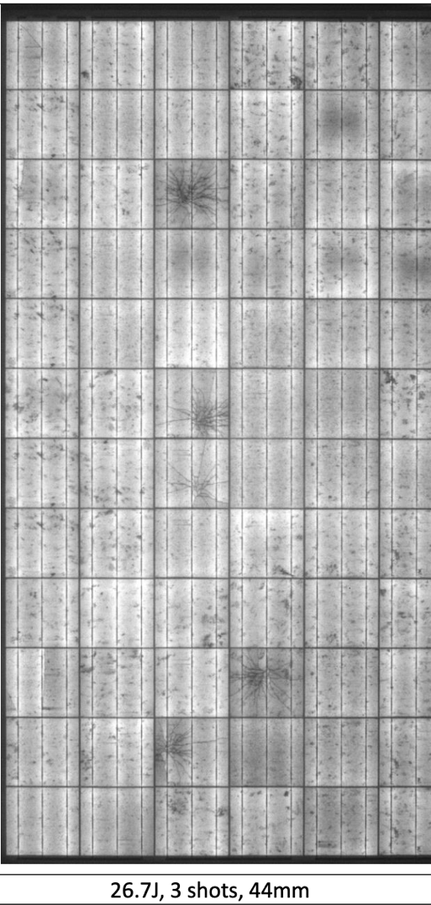
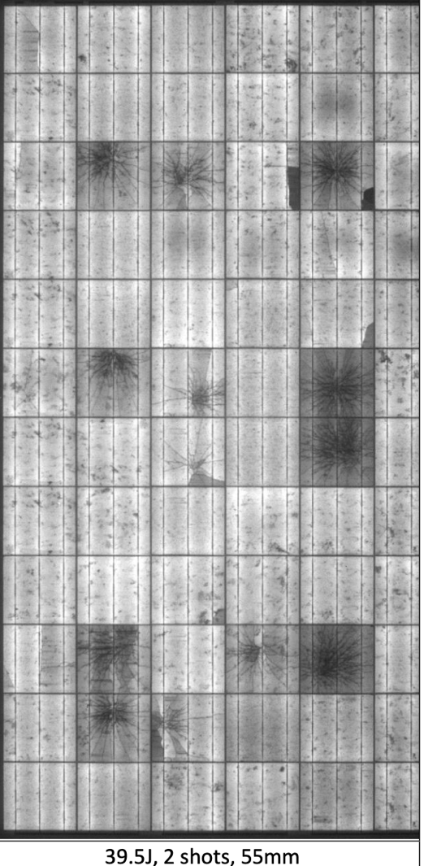
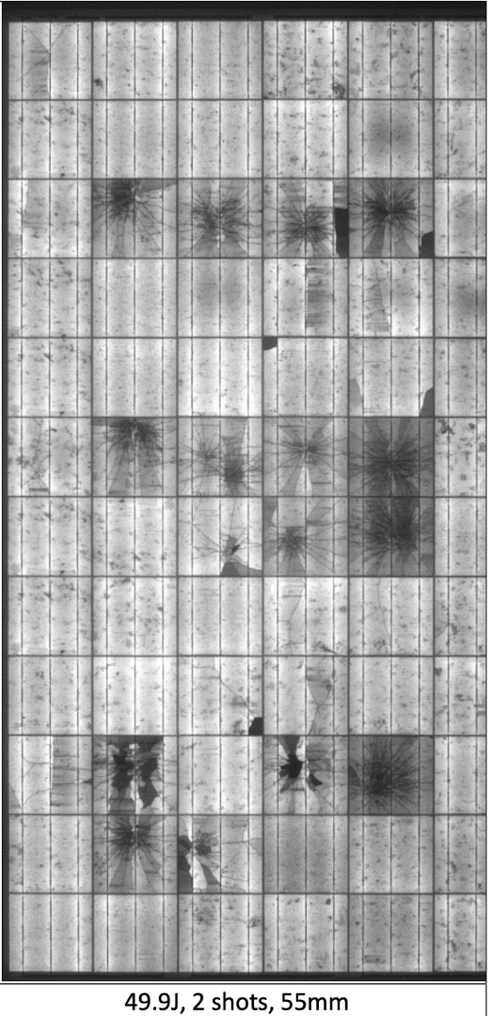
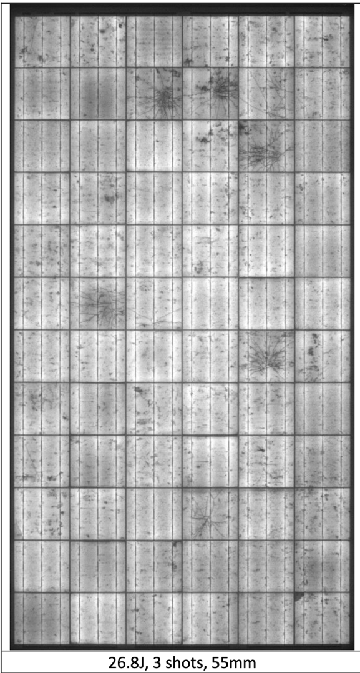
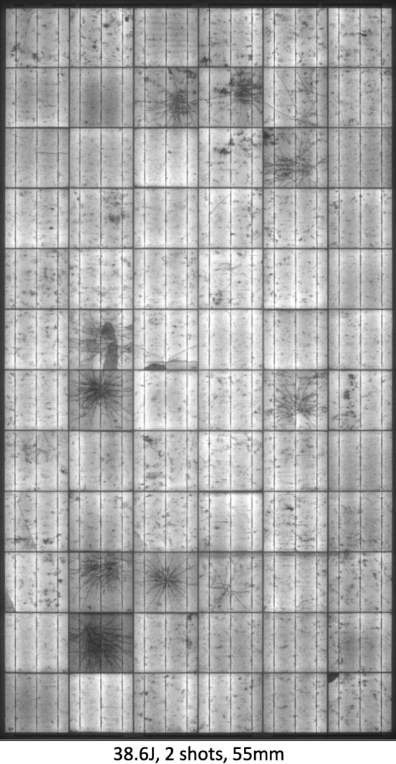
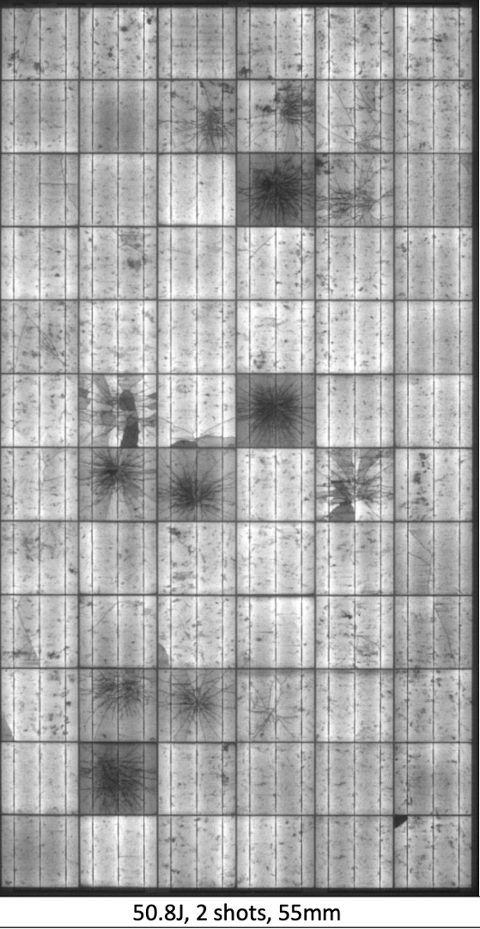
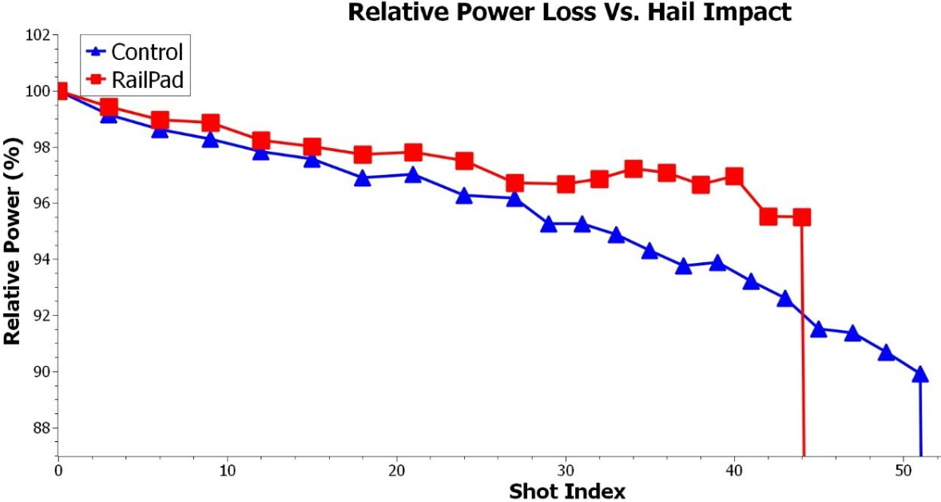

RailPad and Hail
No RailPads
With RailPads
W
EL taken after demounting
  would look even better with rear pressure
  doesn’t prevent dendritic cracks, but seems to reduce open cracks
  Over long term would prevent further crack propagation and crack opening
EL images of Control modules

Slide 18
Future RailPad Research
Observe energy delivery vs time, EL, and thermal images on outdoor RailPad installations
Further hail tests with EL while RailPad is engaged
  How much hail damage is due to the impact vs the deflection?
Cyclic loading with and without RailPads on module with hail damage

Slide 19
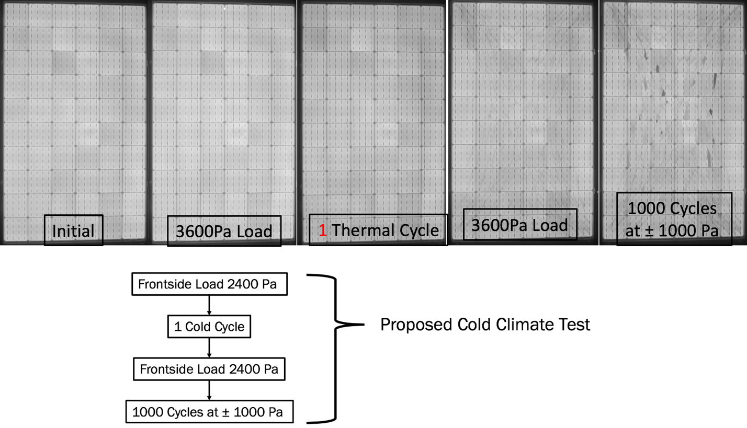
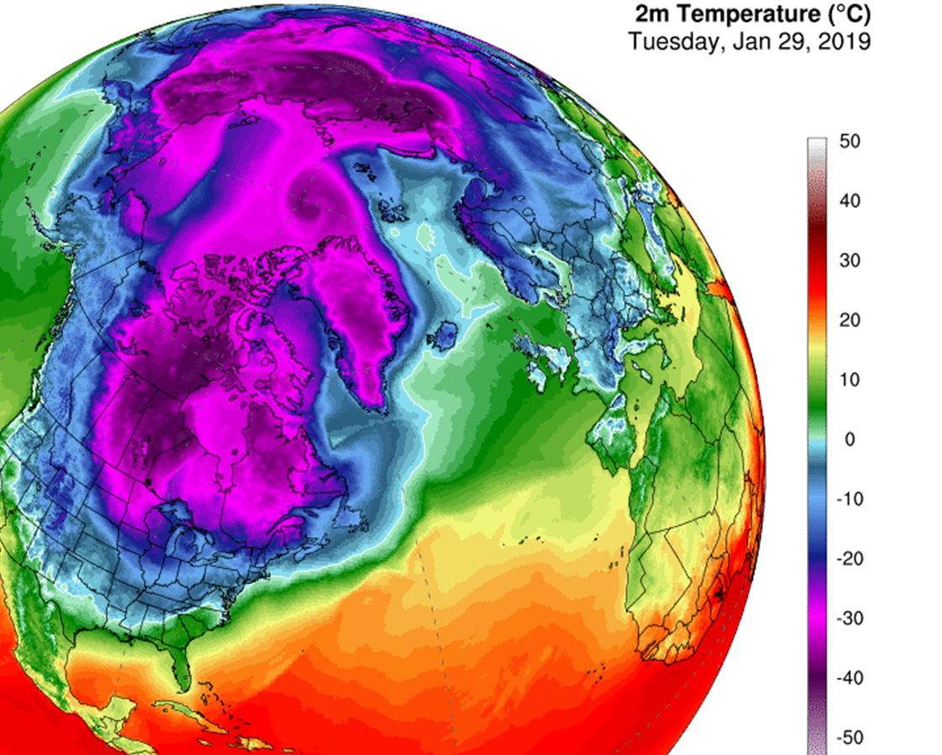
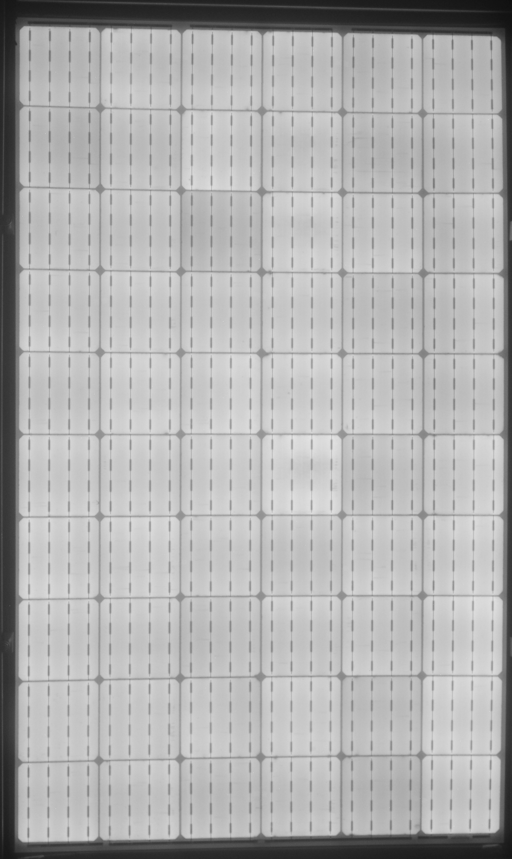
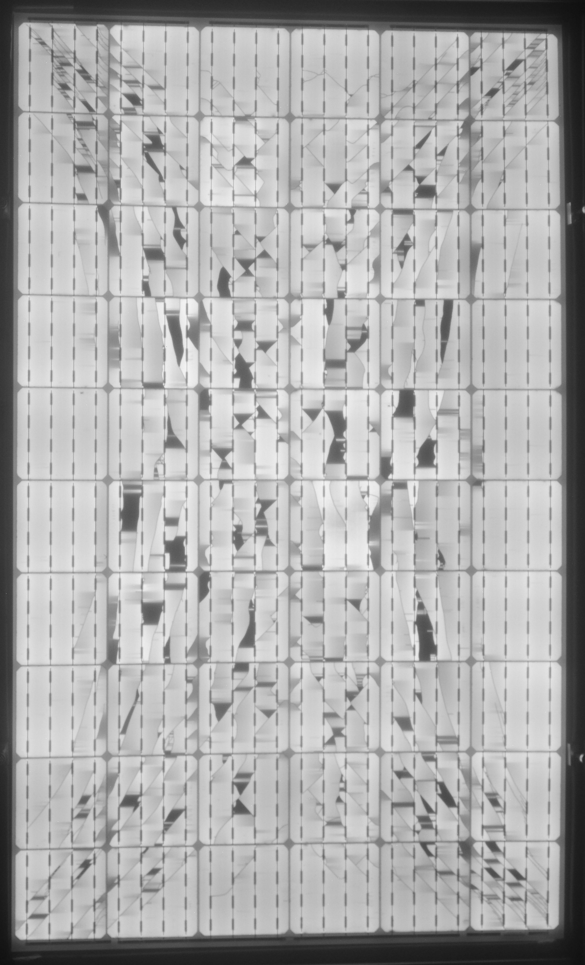
Cold Induced Damage
-30 or -40C
Cold Climate Test
Under 2400 Pa Front Load
BEFORE TC1
AFTER TC1

Slide 20
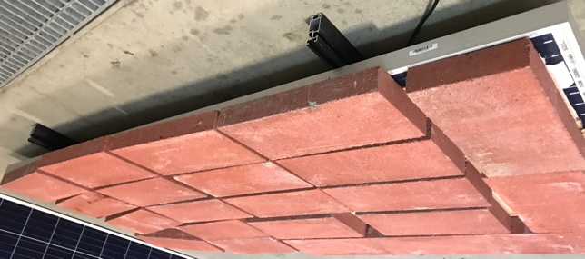
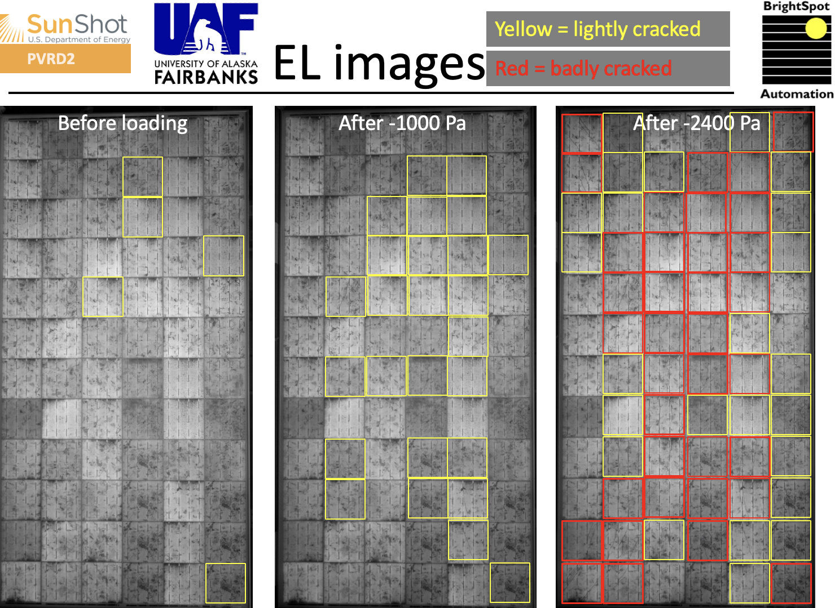
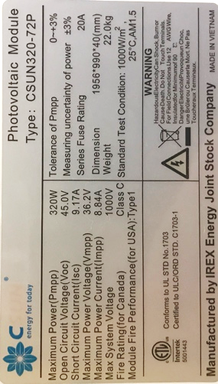
Cold Induced Damage - Outdoor
CSUN modules installed near Fairbanks, AK
  Installed Oct 2018; removed Feb 2020
  Coldest temp seen: -41 ◦ C
EL imaged before and after loading with bricks to different levels
  Data from Chris Pike, U. of AK Fairbanks
Show severe cracking at loads as low as -1000 Pa
  Quite untypical of modern modules
Reduces risk that climate chamber data is misleading in some way

Slide 21
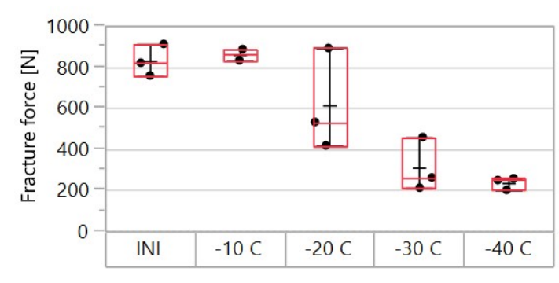
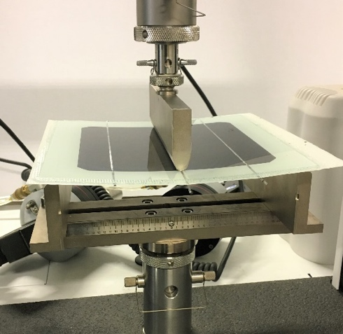
Cold Induced Damage
Fracture force of single cell coupons after a single exposure to these cold temperature
25C
<-30C
glass
glass
Encapsulant shrinks more to right and left of wires than above wires, causing bending of Si and microcracks
wire
EVA
wire
EVA
Si
Si
Al
Al
microcrack

Slide 22
Cold Induced Damage Solutions
Softer and thicker encapsulants help reduce cold induced damage

Slide 23
Future Cold Induced Damage Experiments
Confirm doesn’t occur for glass/glass modules
More testing of modules exposed to cold outdoors
  Are all polymer backsheet modules in the northern U.S. super sensitive to cracking under load?
More experiments with different interconnect designs (round vs flat wires), encapsulant types and encapsulant thicknesses
What about effects on shingled interconnects?
Glass

Slide 24
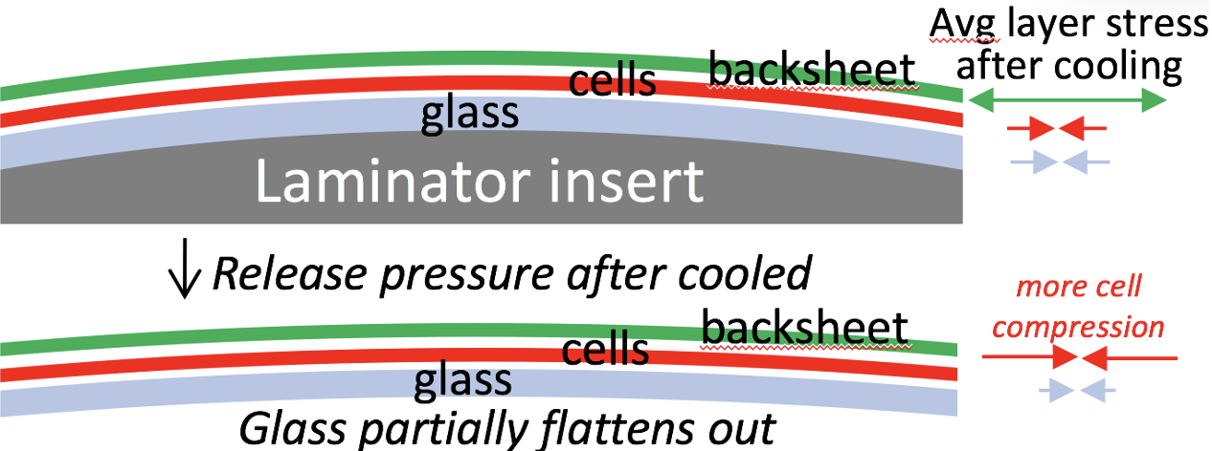
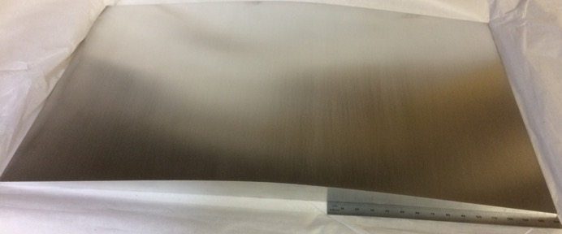
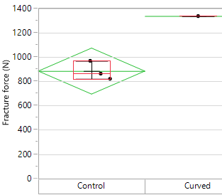
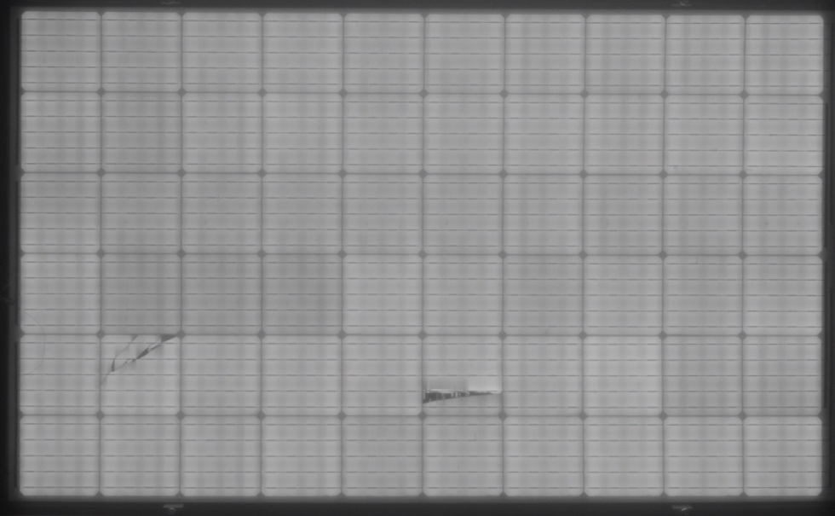
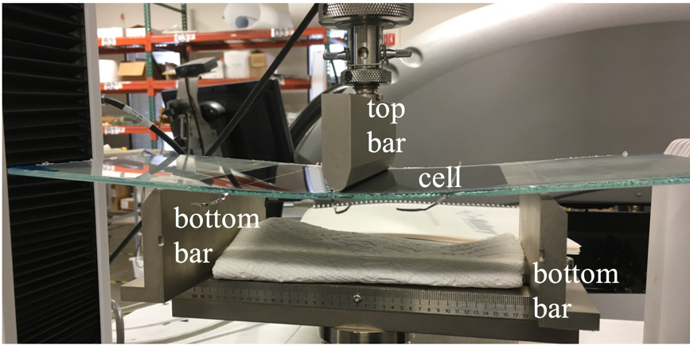
Laminated-In Protective Stress (LIPS)
Standard Control – 4000 Pa
Curved Lamination – 4000 Pa

Slide 25
Future LIPS Experiments
What is the built-in stress state on conventional glass/glass and glass/backsheet modules, what knobs do we have to control it, and does it change over time?
Apply technique to flexible modules
Determine if the protective effect goes away with time and temperature

Slide 26
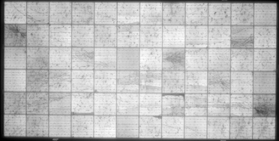
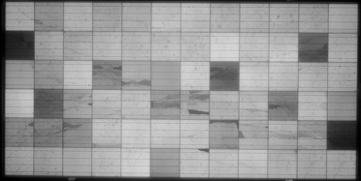
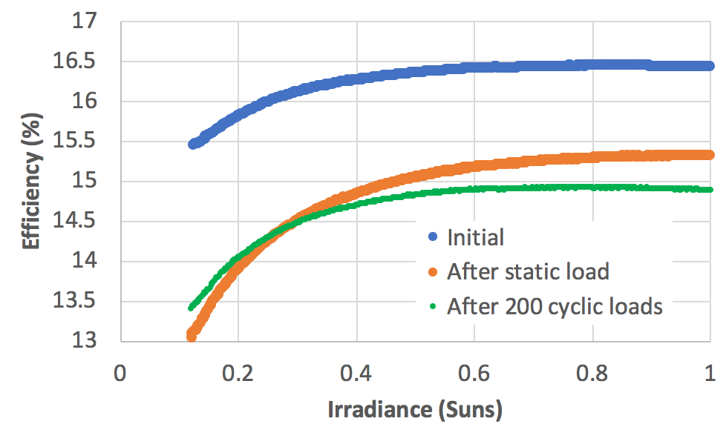




Cracks and Energy Delivery
The shunting of cells with cracks is roughly proportional to the total length of cracks
Shunts drag down light low performance more than at 1 Sun
Isc
1/10 Isc
Initial
Static Load
Cyclic Load
Cracks, especially dendritic cracks, affect energy delivery more than Pmax at STC. Same for PID shunting.
Assuming energy delivery degradation from Pmax degradation can giving misleading results, especially in less sunny regions

Slide 27

Energy Delivery & Shunting Research
Study every degradation mode in terms of its impact on Eff vs Irradiance and Temp
  Shunting effects make low light performance worse than 1Sun
  Series resistance effects have the reverse effect
We focus too much on STC where modules never operate!
What percentage of hot spots are related in part to cracked cells, and why?
[Jordan – 2017]

Slide 28

Crack types vs load
Cells that crack at higher loads have worse cracks with higher power loss

Slide 29

EL Temperature Effects
Crack closure from EL power supply current
  NREL [Silverman 2019] has seen the opposite with crack opening at higher temps
  Different results for chamber heating vs resistive heating?
Relevance of room temp EL to hotter modules in the field?
Opportunity for ”cheating” for IEC testing

Slide 30



Finger/Busbar Interruption Research
UVF shows hidden (to EL) cracks under/near busbars
  Use accelerated UV chamber or damp heat chamber to study problem?
Often see “dark fingers” particularly after chamber testing
  Solely from these parallel cracks?
  Importance of wire to busbar alignment?
Wire
Finger
Busbar
Finger
Si
EL vs time at -Isc

Slide 31




Microcracks and Short Cracks as Origin of Cracks Propagating Under Load
S=short
L=Long
D=dendritic
S
S
S
S
S
S
S
S
S
D
S
0 Pa (initial)
S
S
1000 Pa
S
S
S
S
S
S
L
D
D
S
D
D
S
S
S
D
S
S
L
L
D
L
L
L
L
S
S
S
S
L
L
L
D
D
D
S
S
5600 Pa
2400 Pa
S
S
S
S
S
S
D
S
S
L
D
D
L
D
D
D
D
D
D
S
D
S
S
D
S
S
S
L
D
L
D
D
D
D
D
D
L
L
L
L
D

Slide 32

Microcracks and Short Cracks as Origin of Cracks Propagating Under Load
Most short cracks propagated under load into long or dendritic cracks
Few good cells cracked under load
  But those that did crack at 5400 Pa shattered completely

Slide 33
New Cracking Under Load Research
How do transportation stresses affect crack propagation and why? Just from tensile stress from front side deflection?
How can we design cells/modules so that dendritic cracking never happens from loading events?
  Introduce defects on purpose that produce clean long cracks with minimal power loss?
  Process modules with large cells for ease/cost of handling/processing, but then bend after lamination to split into subcells?
Compare V-crack and X-crack propagation in glass/glass vs glass/backsheet modules for both cyclic loading and thermal cycling
  Develop different factory and field acceptance criteria in terms of the number of such cracks allowed
  Quantify energy delivery benefit in terms of $ and translate to differential insurance premiums
We need better financial drivers for adoption of the more robust technologies

Slide 34

V-crack Modeling Research
Modeled a freestanding cell with wires cooling from 25 to -40C
Saw stress patterns corresponding to the shapes seen in the ”V-crack” soldering defect
Could apply this model to cooling down from the soldering temperatures to help improve that processing step
Stress in the ‘X’ direction

Slide 35
Module Buying Decision Matrix (from cell crack risk perspective)
 | Action | Response
1 | See if glass/glass is acceptable | Use glass/glass (In hail-prone areas use thickness glass possible); If not, then:
2 | Ask to see internal EL acceptance criteria | Choose top candidates with the strictest criteria
3 | Look at some sample factory EL images from different lines | Consider only manufacturers with high resolution, optimized EL where can see short V-cracks. (If you can’t see it, you can’t control it)
4 | Look at many factory EL images from randomized lines and dates, zoomed in | Choose top candidates who are following their own acceptance criteria and who have the lowest rate of V-cracks and other problems
5 | Ask to see EL images from IEC61215, IEC TS 63209-1 ED1, and high energy hail testing before & after the test legs | Choose top candidates with the least crack creation and propagation
6 | Ask to see BOM details for front encapsulant thickness and wire+solder thickness | Choose top candidates with the largest value of (encapsulant thickness – wire thickness), especially if installing in a cold regions

Slide 36












Thank You
EL
PL
Look while you load

