Slide 1

Do Those Short Solar Cells Cracks That I Can Barely See in EL Really Matter?
Andrew M. Gabor* – BrightSpot Automation Duncan W. J. Harwood – D2 Solar
Abstract/Background
Experiment
Results
Conclusions
Short cracks at the tips of busbars are commonly seen in solar panels
These cracks are hard to see unless electroluminescence (EL) camera systems have high resolution and are well optimized and one zooms in to actively look for them
Thus, most short cracks go unobserved in factory and field EL testing
Even if they are observed, acceptance criteria are often very loose for such cracks
Should we be more concerned?
Here we study how cracks evolve in polymer-backsheet modules containing several of such cracks as the front side mechanical load is ramped
EL testing was performed on 2 modules containing cells with several short cracks
Modules were placed under a ramped mechanical load in the LoadSpot tool while new EL images were captured at various load levels
Cracks in each cell were counted and type-classified at each load level
Almost all of the short cracks propagated into long or dendritic cracks
Cells with no observable short cracks prior to loading rarely formed cracks under loading
However, if a good cell does crack under high load, it shatters dramatically
Wind, snow, and human loads can propagate short cracks in ways that decrease energy delivery
The industry should consider more strict acceptance criteria for such cracks at both the factory and field
Conversely, the worst dendritic cracking under load happens for cells with no pre-existing cracks, and built-in cracks for stress relief under load is a conceivable design strategy, especially for cells with many interconnect wires
In order to see short cracks, the industry will need to implement higher resolution EL camera systems with better optimized settings, post processing, and operator interfaces
Ideally, machine learning algorithms will be optimized to automatically detect such cracks
Acceptance criteria for cracks in glass/glass modules might be looser since cracks may be less likely to propagate. This would be a financial incentive for adoption of such modules.
This material is based upon work supported in part by the U.S. Department of Energy’s Office of Energy Efficiency and Renewable Energy, in the Solar Energy Technologies Program, under Award Number DE-EE0008152

Slide 2
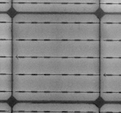
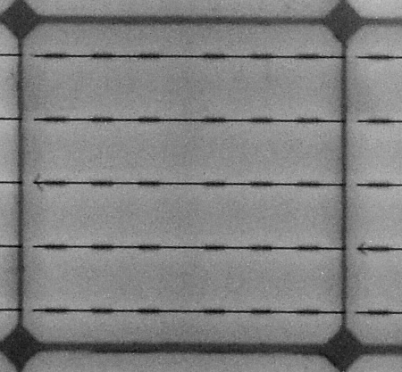
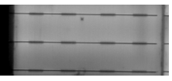
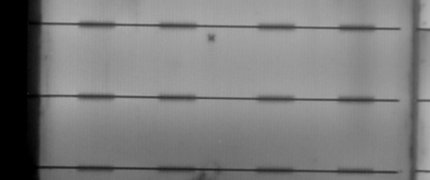
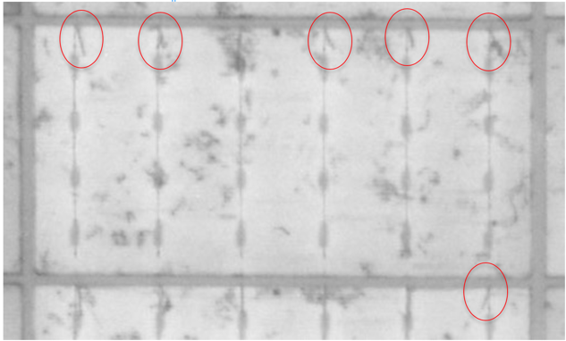
Abstract/Background
  Poor soldering
See a lot of short cracks on new modules
With high resolution EL and zooming in you can see them
With lower resolution EL and not looking closely, you will miss them
  Manufacturers sometimes don’t want to see them
  EL systems are often poorly optimized
Acceptance criteria at the factory and in the field will often allow large numbers of such cracks
  But short cracks can propagate under load. Does this make sense?
  Rear impacts
  Poor laser scribing

Slide 3
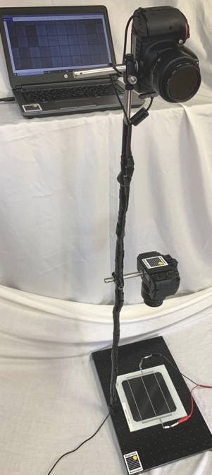
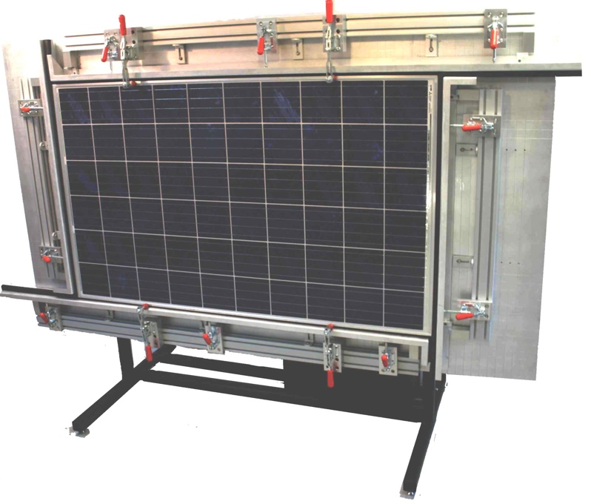
Experiment
2 modules with polymer backsheet, PERC cells, different lamination methods
Take high resolution images with BrightSpot 24Megapixel EL camera system
Analyze images and note locations of short cracks
Ramp the front side load with LoadSpot mechanical load tester to 5600 Pa
Dwell at several intermediate pressures and take new EL images
Analyze all images for cracks and crack type (Short, Long, Dendritic (Spiderweb)
See whether new cracks are correlated to the location of the pre-existing short cracks
EL Camera
  LoadSpot

Slide 4
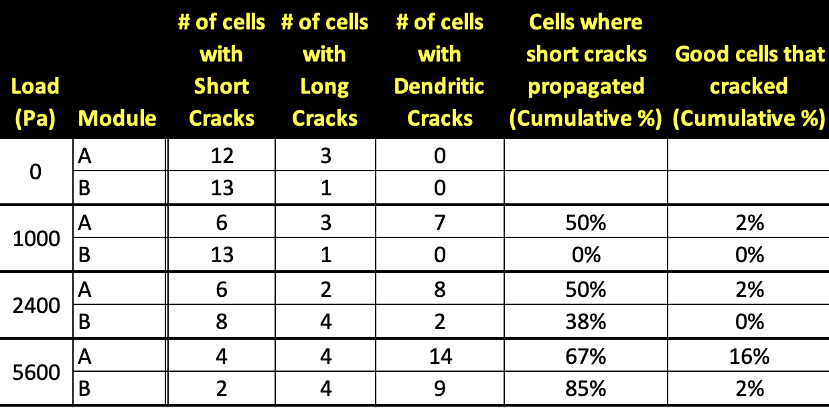
Results
Most short cracks propagated under load into long or dendritic cracks
  Dendritic cracks create dark EL images indicating P_{max} and energy yield degradation
Few good cells cracked under load
  But those that did crack at 5400 Pa shattered completely

Slide 5
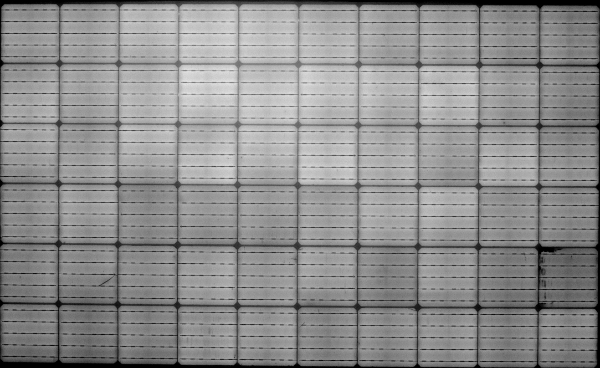
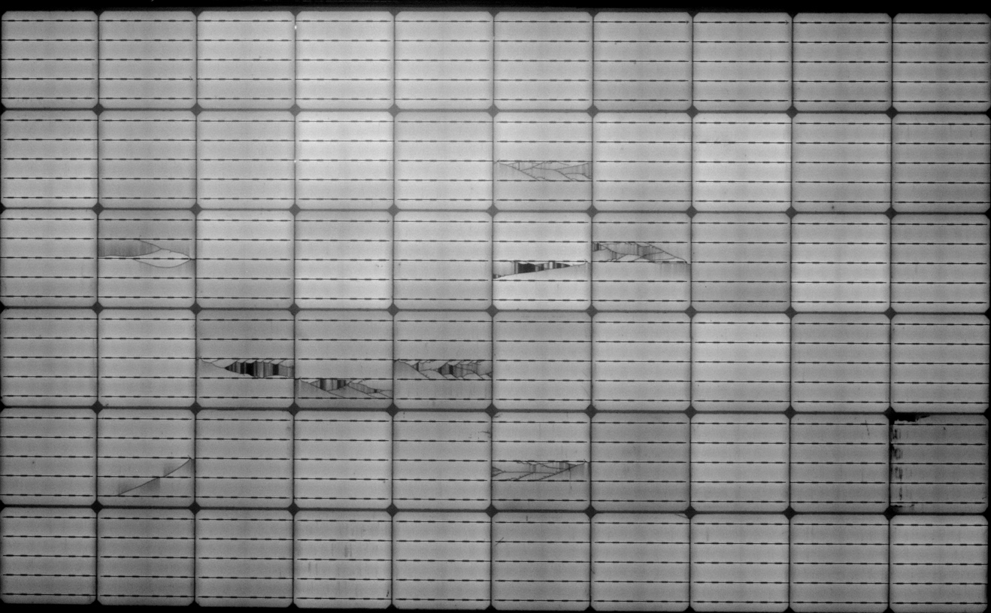
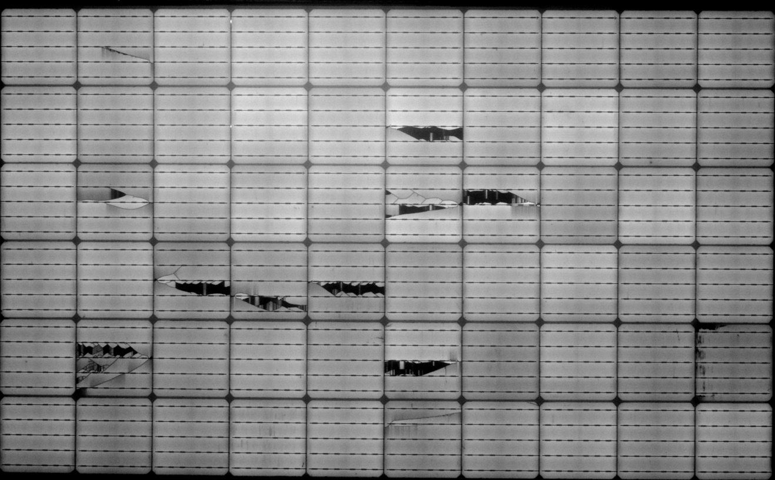
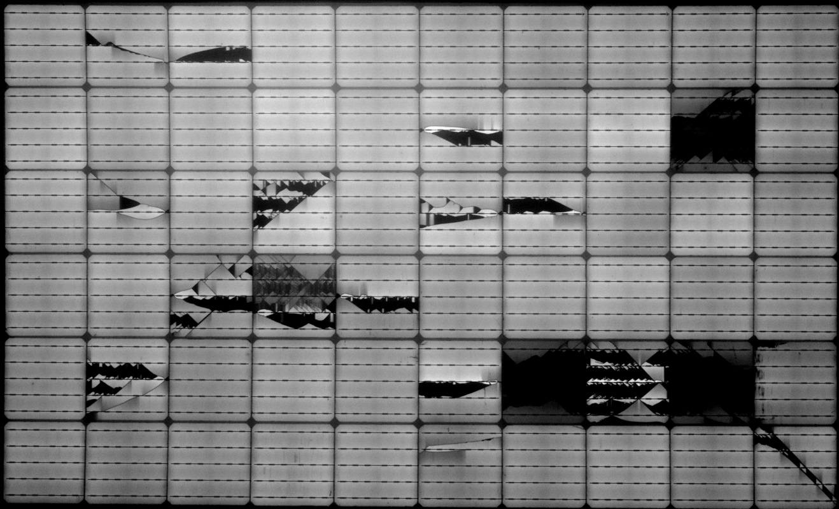
S=short
L=Long
D=dendritic
Results – Module A
S
S
S
S
S
S
S
S
S
D
S
0 Pa (initial)
S
S
1000 Pa
S
S
S
S
S
S
L
D
D
S
D
D
S
S
S
D
S
S
L
L
D
L
L
L
L
S
S
S
S
L
L
L
D
D
D
S
S
2400 Pa
5600 Pa
S
S
S
S
S
S
D
S
S
L
D
D
L
D
D
D
D
D
D
S
D
S
S
D
S
S
S
L
D
L
D
D
D
D
D
D
L
L
L
L
D

Slide 6
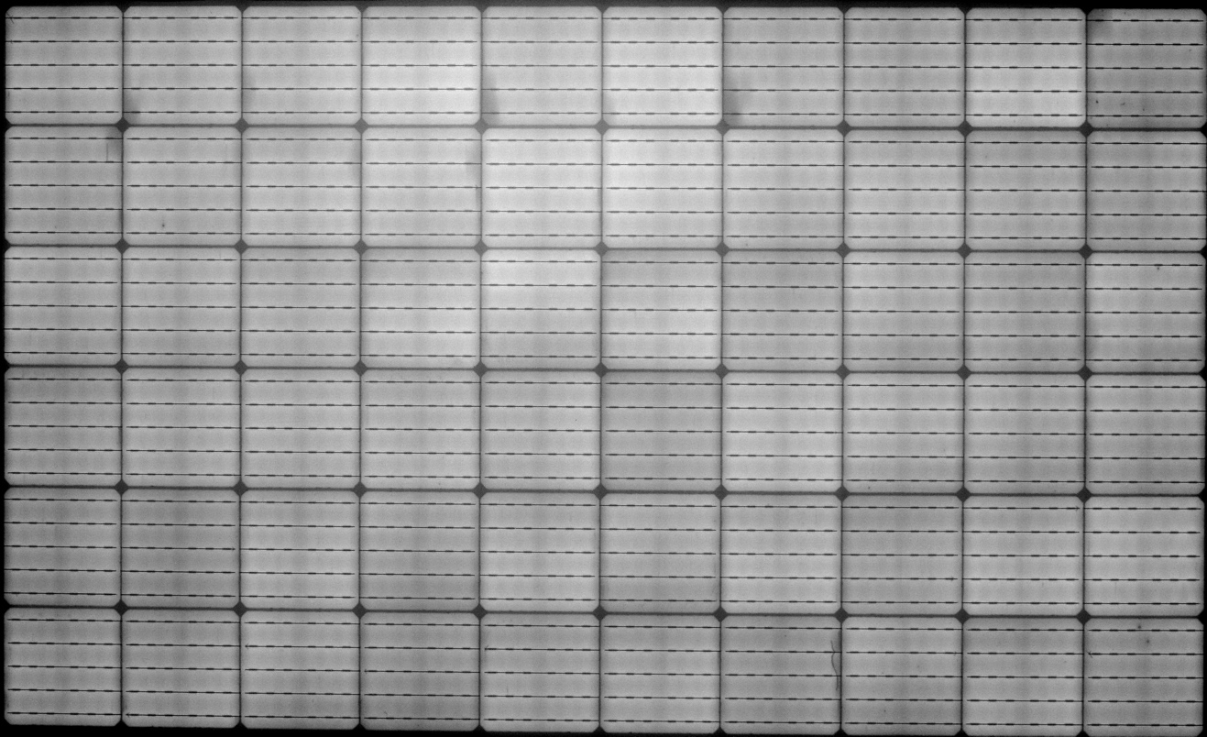

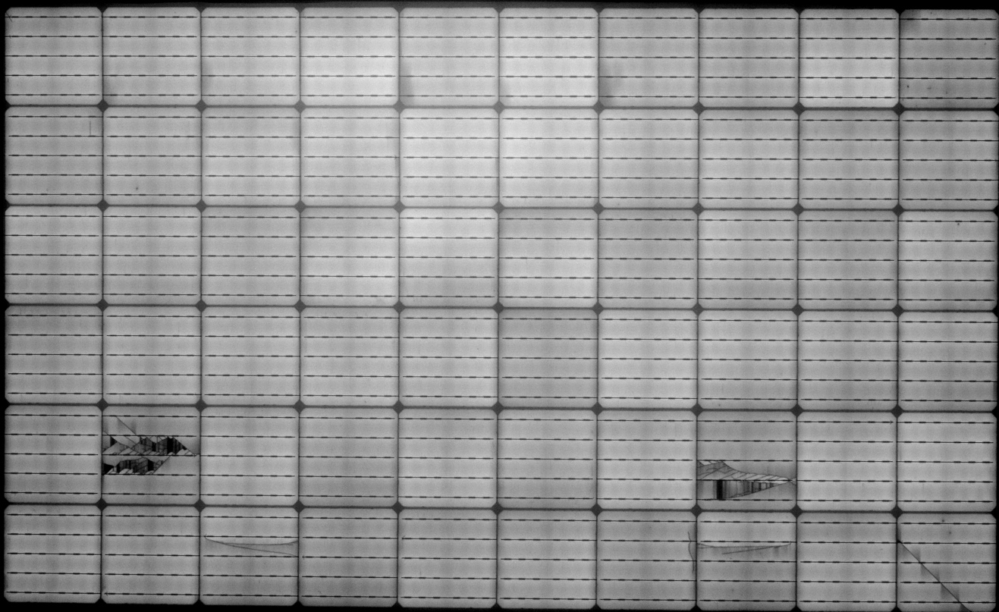
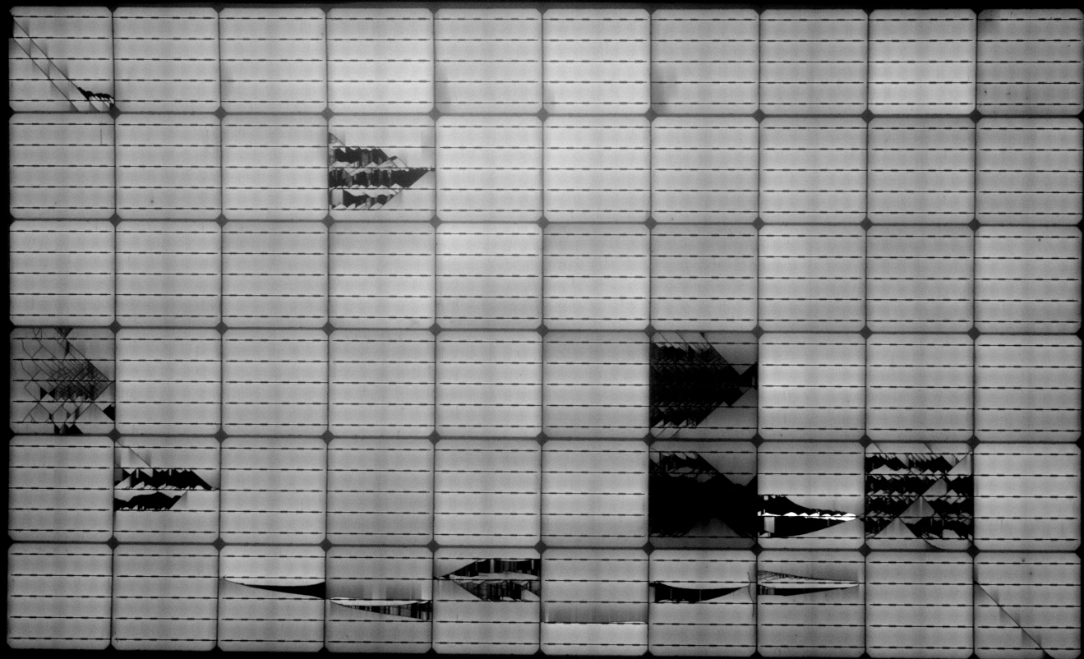
S=short
L=Long
D=dendritic
Results – Module B
S
S
S
S
0 Pa (initial)
1000 Pa
S
S
S
S
S
S
S
S
S
S
S
S
S
L
S
S
S
S
S
L
S
S
S
S
S
D
S
S
D
5600 Pa
2400 Pa
S
S
S
S
D
D
S
S
D
S
D
D
S
D
S
D
S
S
S
S
S
S
S
L
S
L
S
L
L
S
D
L
S
L
S
L
S
D
L
Most s

Slide 7
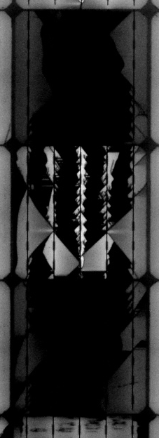
Conclusions
Just ’cause they’re hard to see, doesn’t mean they’re not important
  Short cracks can easily propagate under load (wind, snow, human) and cause P_{max} and energy delivery degradation
Some manufacturers have control of short cracks, others do not. Maybe system investors should demand that manufacturers and field testing companies:
  Implement EL camera system that can detect such cracks (high resolution, optimized, enhanced contrast, good operator interfaces)
  Store all image for later reference
  Train their operators to look for these cracks (or implement machine learning for automated crack detection)
  Implement more stringent acceptance criteria for the number of short cracks
But we’ve got all these wires now on the new cells that can minimize “lost area” with simple long cracks. It’s the dendritic cracks that are the big problem now if they do happen due to both lost area and shunting
  Should we design “weak” cells that propagate long cracks easily under load so that shattering of cells at high loads never happens?
With glass/glass module construction, cells should not enter a state of high tensile stress under load, and the short cracks should be less likely to propagate. Is it fair to subject them to the same acceptance criteria as polymer backsheet modules?
  With looser criteria significant cost savings could be had in terms of factory yields, shipping yields, and field testing (O&M) costs. These savings could help drive adoption.
  Need to examine load testing and thermal cycling data on cracks in glass/glass modules

